Slide 1
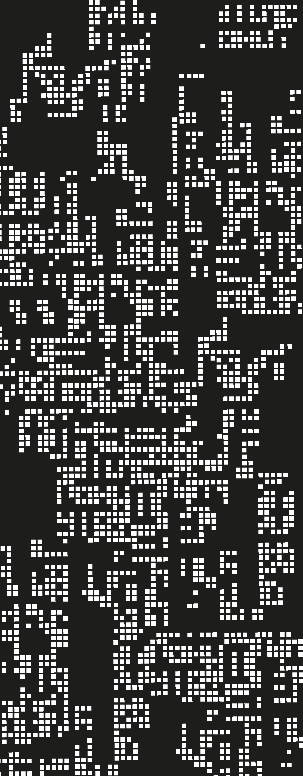
Basics
3. Language Structure + AE implementation

Slide 2
Contents
01
The main process
02
AE Language
03
Expanding the process
04
Farewell, section 1

Slide 3

Before, let’s remember concepts
Expressions
Evaluation
Statements
Are anything that can be reduces or produces as result a value
Reduce an expression to the minimum possible
Group of expressions or statements that express a task or an action
(+ 2 (- 3 1))
(+ 2 (- 3 1))
(+ 2 2))
4

Slide 4
The main process
(+ 3 4)
7
So, how do we go from box-to box?

Slide 5
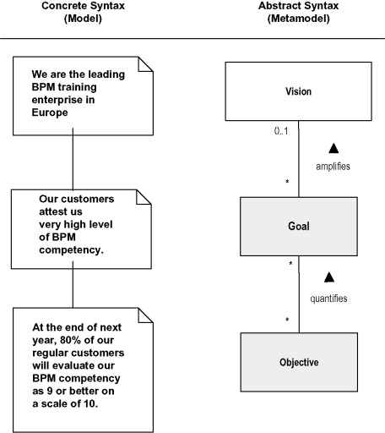
Concrete vs Abstract Syntax

Slide 6

Concrete Syntax
Abstract Syntax
6
{+ 1 3}
{- 3 1}
(num 6)
(add (num 1) (num 3))
(sub (num 3) (num 1))

Slide 7

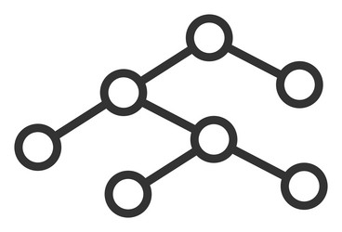
Concrete Syntax
Abstract Syntax
parse
interp
Value
Source Code
Abstract Syntax Tree

Slide 8
Abstract Syntax Tree
(+ 3 4)
(add left right)
Add
Left Right
Num 3
Num 4

Slide 9
parse
interp
Value
Source Code
Abstract Syntax Tree
Syntax
Semantics

Slide 10
analyze
parse
interp
Value
compile
optimize
Source Code
AST
exec
IR (bytecode)
ExprL2
Church - Turing

Slide 11
Functions
parse : src → expr
interp : expr → val
analyze : expr → info / type / ext
optimize : expr → expr
transform : expr → expr
compile : expr(L1) → expr(L2) / IR(L2)
exec : IR → val

Slide 12
Summary
Interpreters show the semantics of a language.
From source code, we have to make different steps to arrive to a value.

Slide 13
On next class
Substitution

Slide 14
References
PrePLAI, section 5

